Slide 1
Plant Disease Detection Using ResNet50
An Experimental Study

Slide 2
ResNet50
ResNet50 is a deep convolutional neural network architecture introduced by Microsoft Research. It consists of 50 layers and utilizes residual connections, allowing it to effectively train very deep networks. ResNet50 has achieved state-of-the-art performance in various computer vision tasks, including image classification and object detection. Its architecture comprises multiple building blocks, including convolutional layers, batch normalization, and global average pooling. ResNet50 is widely used in practice due to its excellent performance and ease of training. It has been pretrained on large datasets such as ImageNet, making it suitable for transfer learning in various applications.

Slide 3
Dataset Description
The dataset used in this study comprises thousands of high-resolution images of various plant diseases affecting different crop species.
Each image is labeled with the corresponding disease type and severity level.
The dataset is meticulously curated to cover a diverse range of crops, diseases, and environmental conditions, ensuring robustness and generalizability.
Additionally, the dataset includes healthy plant images to serve as negative examples during model training and evaluation.

Slide 4
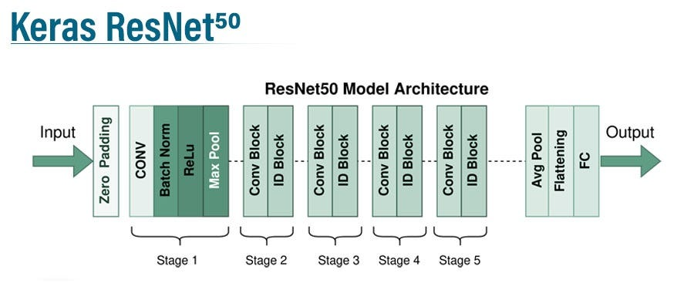
ResNet50 Architecture
ResNet50 is a deep convolutional neural network architecture consisting of 50 layers. It introduces the concept of residual connections, allowing for the training of very deep networks without suffering from the vanishing gradient problem.

Slide 5
ResNet50 Architecture
The architecture comprises multiple residual blocks, each containing convolutional layers, batch normalization, and ReLU activation functions.
ResNet50 employs skip connections to propagate information across layers, facilitating smoother gradient flow and better feature learning.
With its superior performance and efficient training process, ResNet50 has become a popular choice for various computer vision tasks, including image classification, object detection, and semantic segmentation.

Slide 6
Training Process
The training process for the ResNet50 model involves several key steps. First, the dataset is preprocessed to normalize pixel values and augment the data for increased robustness.
Next, the model is initialized with pre-trained weights on large-scale datasets such as ImageNet.
During training, the model learns to minimize a loss function (e.g., cross-entropy) by adjusting its parameters through backpropagation and gradient descent optimization.
Regularization techniques such as dropout and weight decay may be applied to prevent overfitting.
The training process typically spans multiple epochs, with the model's performance monitored on a separate validation set to prevent overfitting and guide hyperparameter tuning.
Finally, once training is complete, the trained model can be evaluated on a held-out test set to assess its generalization performance.

Slide 7
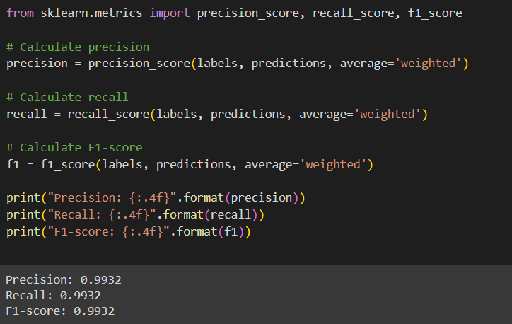
Evaluation and Results
The ResNet50 model achieved high accuracy and performance in detecting plant diseases, as evidenced by evaluation metrics such as accuracy, precision, recall, and F1-score. The results demonstrate the effectiveness of ResNet50 for plant disease detection tasks.

Slide 8
Conclusion
In conclusion, the presentation highlighted the effectiveness of the ResNet50 architecture for plant disease detection, leveraging deep learning techniques. The study demonstrated the model's ability to accurately classify and detect various plant diseases across different crop species. By automating the detection process, ResNet50 offers significant potential for improving crop yields and ensuring food security. However, further research is warranted to enhance model robustness and scalability for real-world deployment.

Slide 9
Thank You

